Slide 1

Hyperparameter tuning
Tuning process
deeplearning.ai

Slide 2
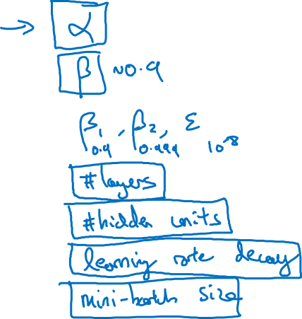
Hyperparameters

Slide 3
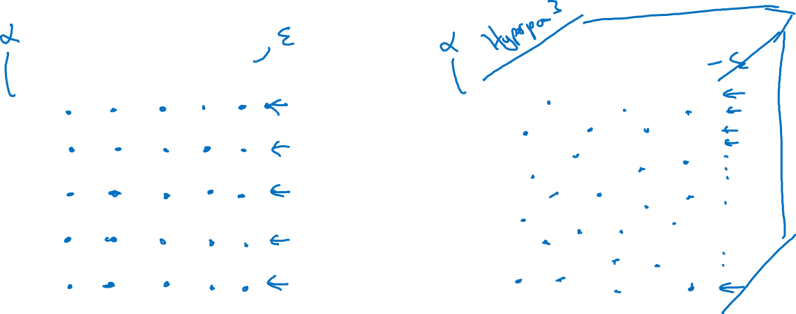
Try random values: Don’t use a grid
Hyperparameter 2
Hyperparameter 2
Hyperparameter 1
Hyperparameter 1

Slide 4
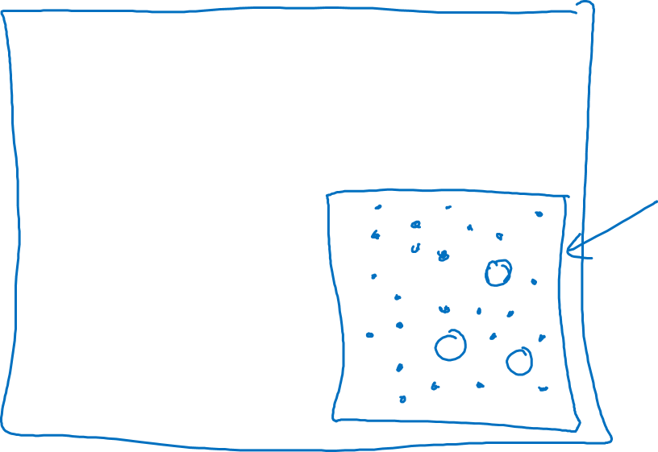
Coarse to fine
Hyperparameter 2
Hyperparameter 1

Slide 5
Hyperparameter tuning
Using an appropriate scale to pick hyperparameters
deeplearning.ai

Slide 6
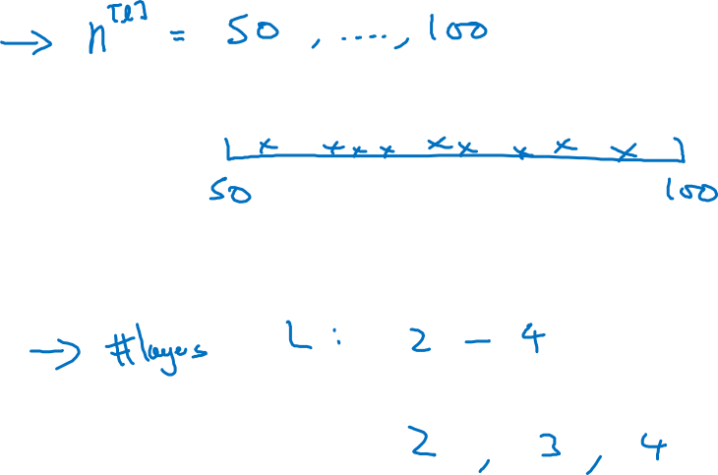
Picking hyperparameters at random

Slide 7
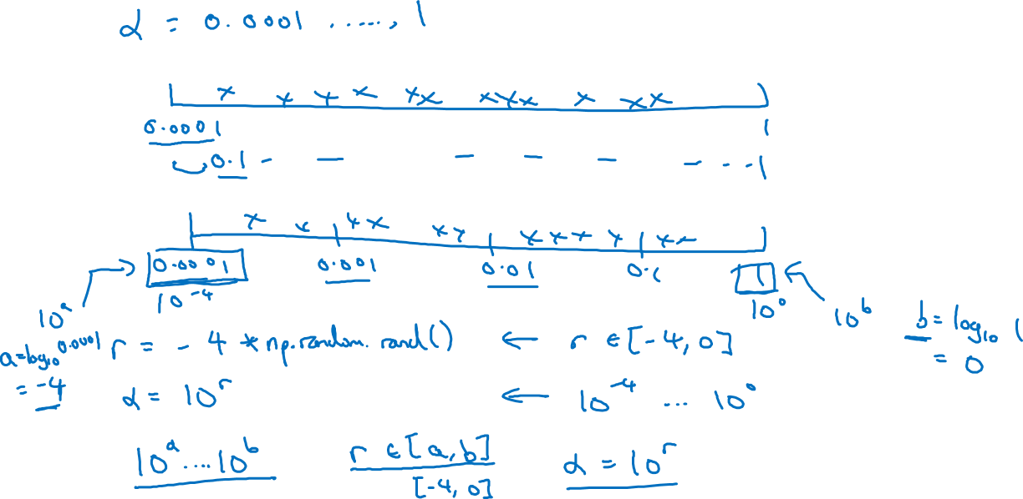
Appropriate scale for hyperparameters

Slide 8
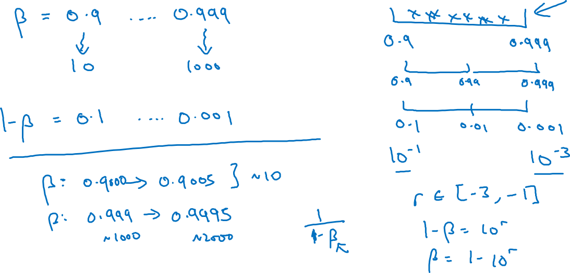
Hyperparameters for exponentially weighted averages

Slide 9
Hyperparameters tuning
Hyperparameters
tuning in practice:
Pandas vs. Caviar
deeplearning.ai

Slide 10


Re-test hyperparameters occasionally
Idea
NLP, Vision, Speech,
Ads, logistics, ….
Intuitions do get stale. Re-evaluate occasionally.
Experiment
Code

Slide 11
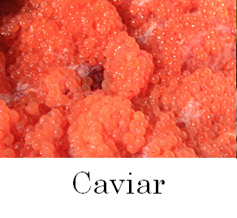
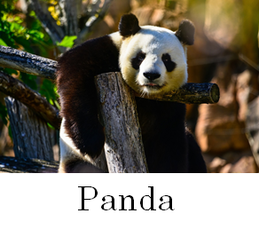
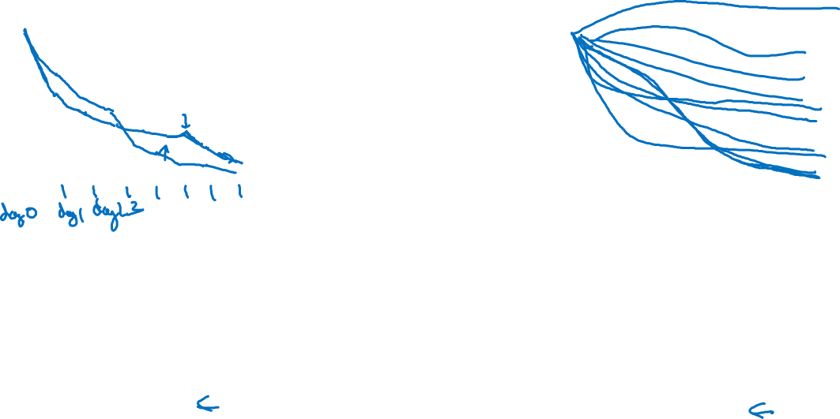
Babysitting one model
Training many models in parallel

Slide 12
Batch Normalization
Normalizing activations
in a network
deeplearning.ai

Slide 13
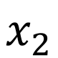
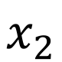
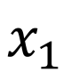
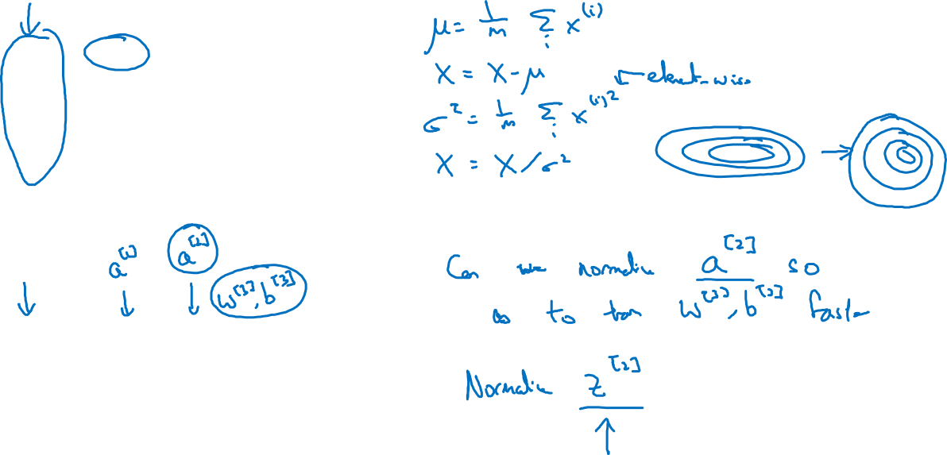
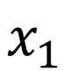

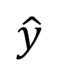
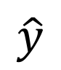
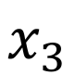
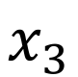
Normalizing inputs to speed up learning
$$x_{1}$$
$$w,b$$
$$x_{2}$$
$$\hat{y}$$
$$x_{3}$$
$$x_{1}$$
$$x_{2}$$
$$\hat{y}$$
$$x_{3}$$

Slide 14
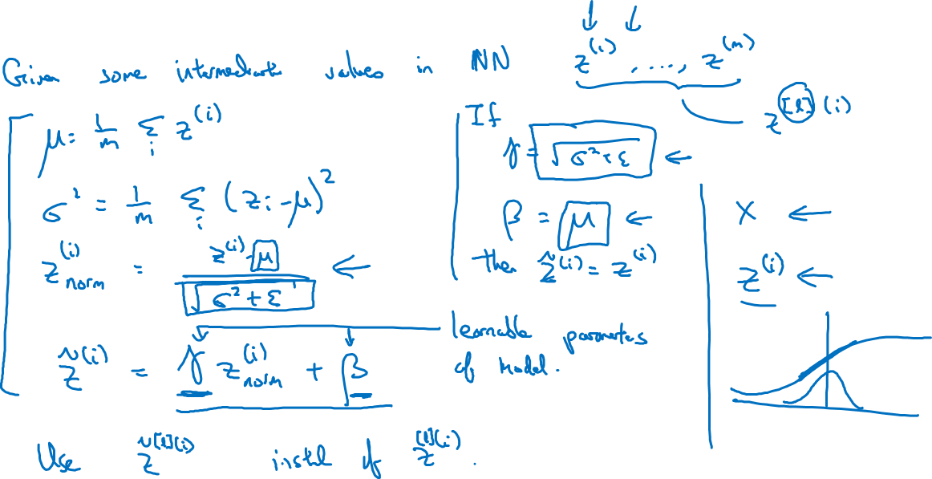
Implementing Batch Norm

Slide 15
Batch Normalization
Fitting Batch Norm
into a neural network
deeplearning.ai

Slide 16
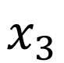
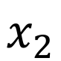
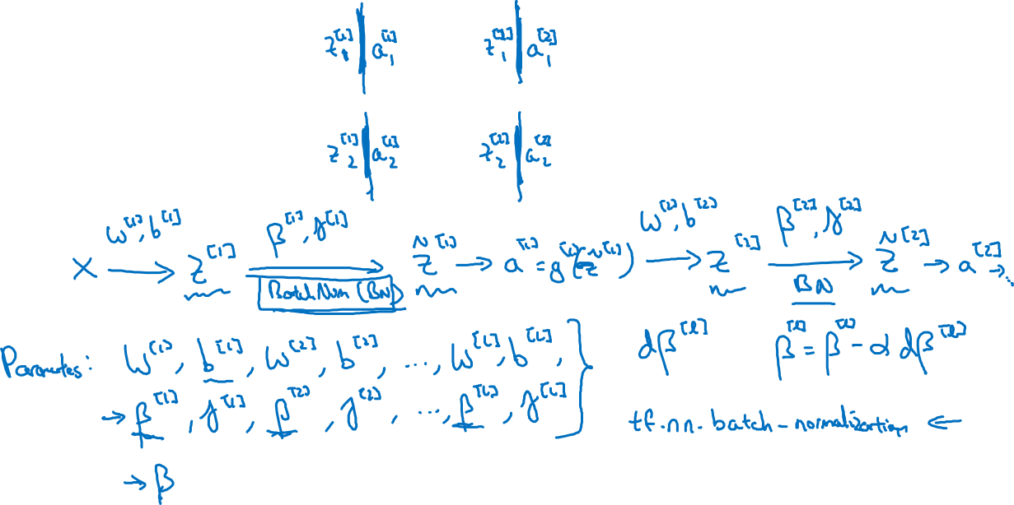
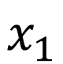
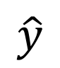
Adding Batch Norm to a network
$$x_{1}$$
$$x_{2}$$
$$\hat{y}$$
$$x_{3}$$

Slide 17
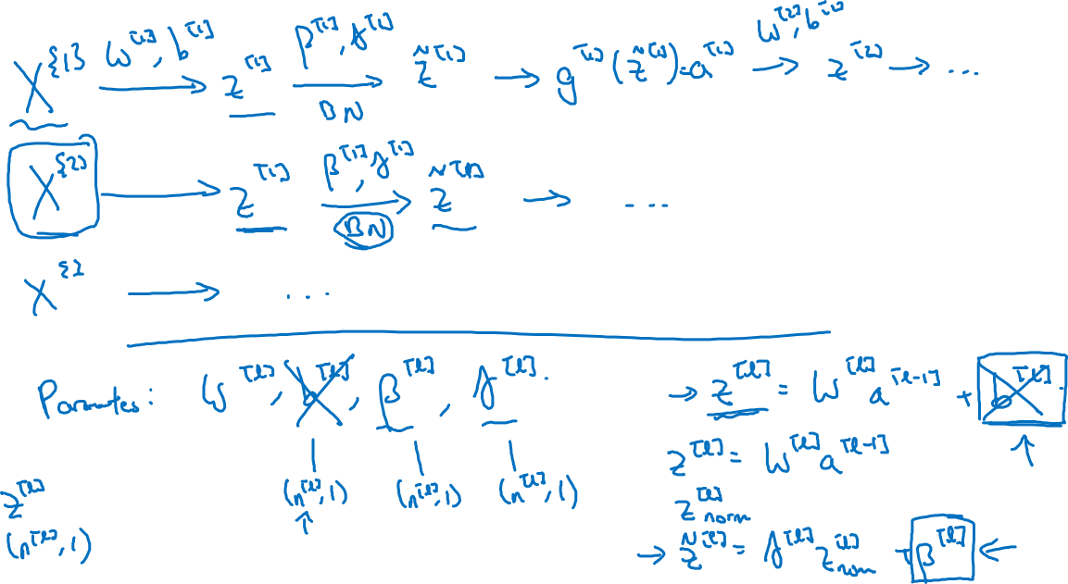
Working with mini-batches

Slide 18
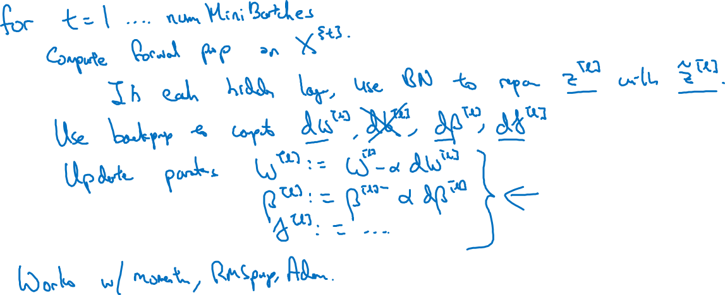
Implementing gradient descent

Slide 19
Batch Normalization
Why does
Batch Norm work?
deeplearning.ai

Slide 20
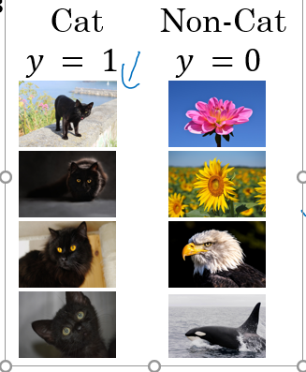
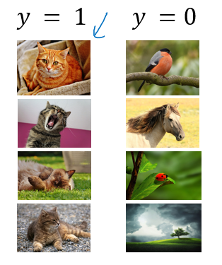
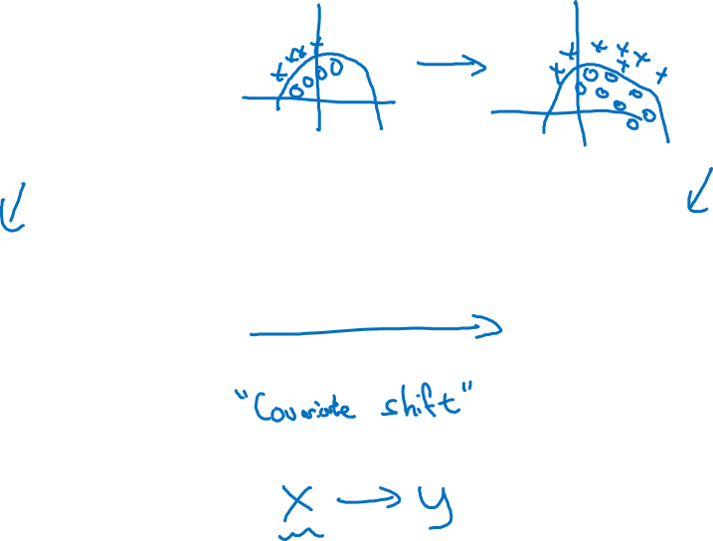
Learning on shifting input distribution
$$x_{1}$$
$$x_{2}$$
$$\hat{y}$$
$$x_{3}$$

Slide 21

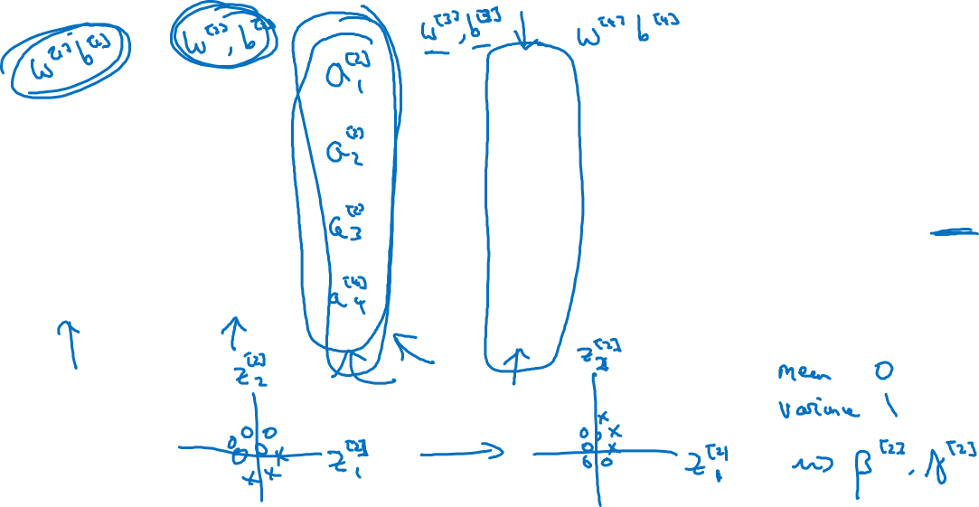

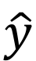

Why this is a problem with neural networks?
$$x_{1}$$
$$x_{2}$$
$$\hat{y}$$
$$x_{3}$$

Slide 22
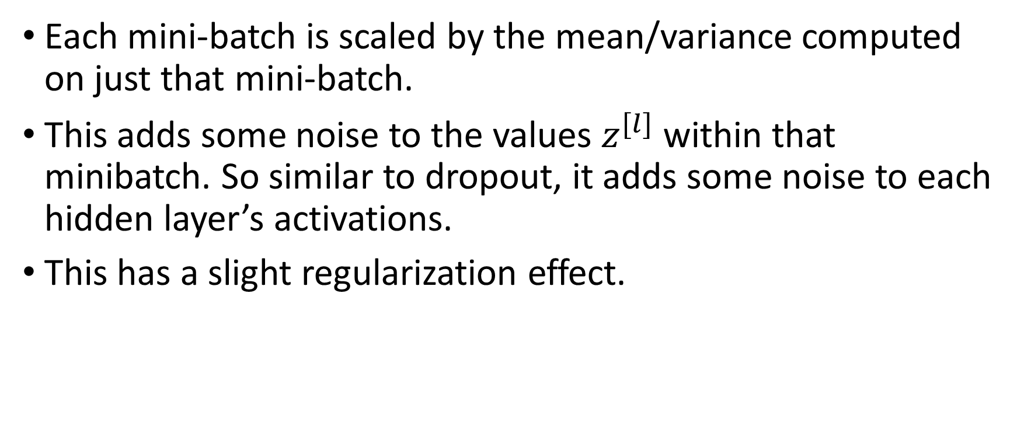
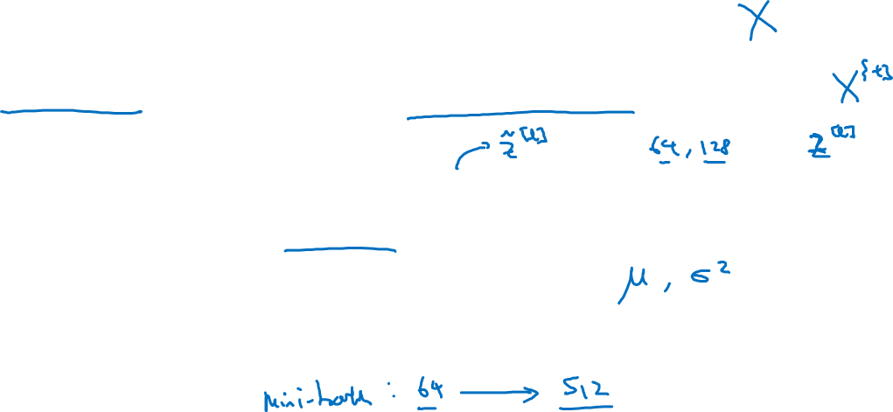
Batch Norm as regularization
Each mini-batch is scaled by the mean/variance computed on just that mini-batch.
This adds some noise to the values $z^{[l]}$ within that minibatch. So similar to dropout, it adds some noise to each hidden layer’s activations.
This has a slight regularization effect.

Slide 23
Batch Normalization
Batch Norm at
test time
deeplearning.ai

Slide 24
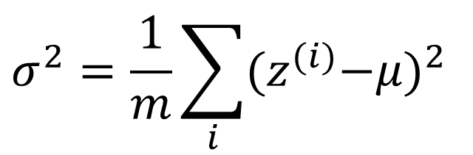
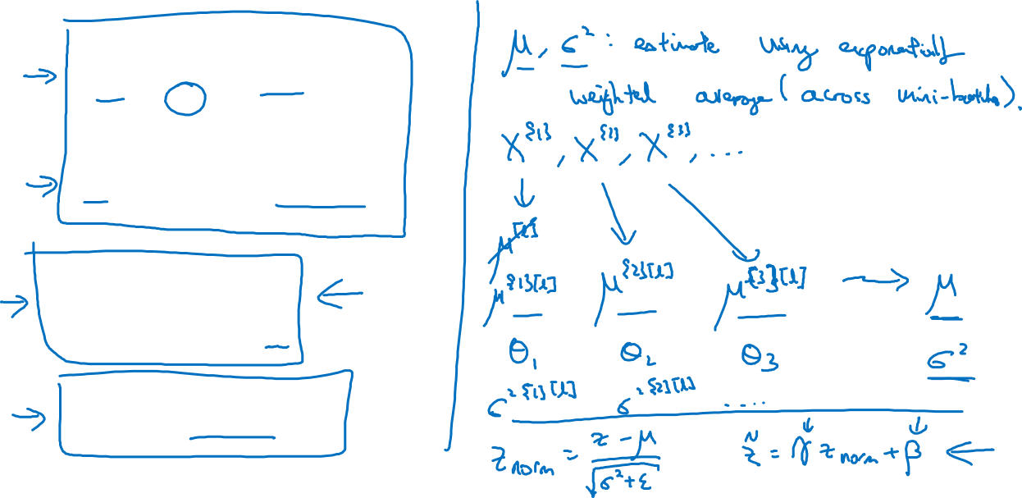
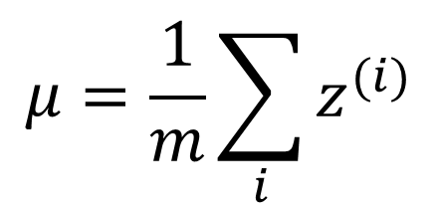
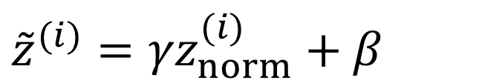
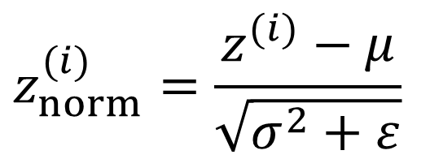
Batch Norm at test time
$$μ=\frac{1}{m}\sum_{i}{z^{(i)}}$$
$$σ^{2}=\frac{1}{m}\sum_{i}{{{(z}^{(i)}−μ)}^{2}}$$
$$z_{norm}^{(i)}=\frac{z^{(i)}−μ}{\sqrt{σ^{2}+ε}}$$
$${{\tilde{z}}^{(i)}=γz}_{norm}^{(i)}+β$$

Slide 25
Batch Normalization
Batch Norm at
test time
deeplearning.ai

Slide 26
Batch Norm at test time
$$μ=\frac{1}{m}\sum_{i}{z^{(i)}}$$
$$σ^{2}=\frac{1}{m}\sum_{i}{{{(z}^{(i)}−μ)}^{2}}$$
$$z_{norm}^{(i)}=\frac{z^{(i)}−μ}{\sqrt{σ^{2}+ε}}$$
$${{\tilde{z}}^{(i)}=γz}_{norm}^{(i)}+β$$

Slide 27
Multi-class classification
Softmax regression
deeplearning.ai

Slide 28
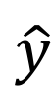
Recognizing cats, dogs, and baby chicks
3
1
2
0
3
2
0
1
X
$$\hat{y}$$

Slide 29
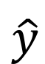
Softmax layer
X
$$\hat{y}$$

Slide 30
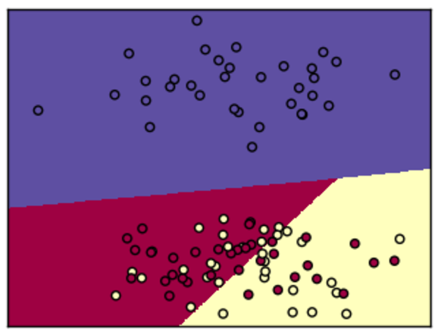
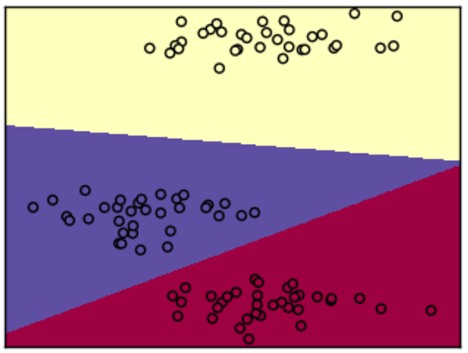
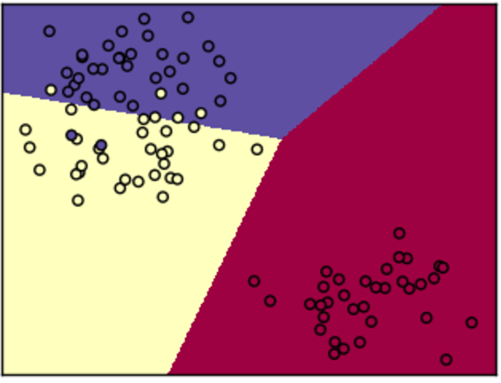
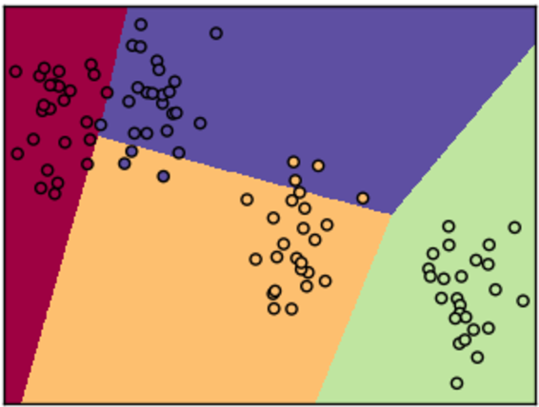
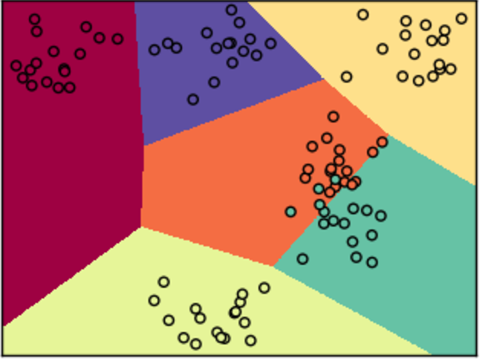
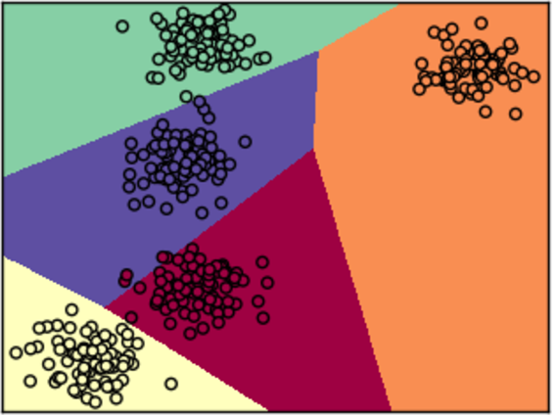












Softmax examples
$$x_{2}$$
$$x_{2}$$
$$x_{2}$$
$$x_{1}$$
$$x_{1}$$
$$x_{1}$$
$$x_{2}$$
$$x_{2}$$
$$x_{2}$$
$$x_{1}$$
$$x_{1}$$
$$x_{1}$$

Slide 31
Multi-class classification
Trying a softmax
classifier
deeplearning.ai

Slide 32
Understanding softmax

Slide 33
Loss function

Slide 34
Summary of softmax classifier
X
$$\hat{y}$$

Slide 35
Programming Frameworks
Deep Learning frameworks
deeplearning.ai

Slide 36

Deep learning frameworks
Choosing deep learning frameworks
Ease of programming (development and deployment)
Running speed
Truly open (open source with good governance)
Caffe/Caffe2
CNTK
DL4J
Keras
Lasagne
mxnet
PaddlePaddle
TensorFlow
Theano
Torch

Slide 37
Programming Frameworks
TensorFlow
deeplearning.ai

Slide 38

Motivating problem

Slide 39

Code example
import numpy as np
import tensorflow as tf
coefficients = np.array([[1], [-20], [25]])
w = tf.Variable([0],dtype=tf.float32)
x = tf.placeholder(tf.float32, [3,1])
cost = x[0][0]*w**2 + x[1][0]*w + x[2][0] # (w-5)**2
train = tf.train.GradientDescentOptimizer(0.01).minimize(cost)
init = tf.global_variables_initializer()
session = tf.Session()
session.run(init)
print(session.run(w))
for i in range(1000):
session.run(train, feed_dict={x:coefficients})
print(session.run(w))
with tf.Session() as session:
session.run(init)
print(session.run(w))

